Slide 1
Building Your Professional Network
Membership Chair, Nia Long

Slide 2
Know Your Why
Better job
Community Outreach
Investing goals
Expand your business
Enhance your influence

Slide 3
Quality v. Quantity
Choose people that adhere to your ‘Why?’
In your industry
Reflections of your current or future self
Choose people and talking points prior to attending the event
Recognize that the right person can change your entire trajectory

Slide 4
Prepare Your Elevator Pitch
The Five W’s
Who you are
What you do
Why you do it
Where you are going
What you can do for them

Slide 5
Make Connections (literally & figuratively)
Have genuine conversations with others by actively listening and committing their attributes to memory
If you meet two people at the same function and feel they would benefit from knowing each other, introduce them!

Slide 6
Provide Value
Ask if there are ways you can help them grow and develop. Lots of people have immediate needs they need met to enhance their business and you inquiring with a ‘how can I help you?’ will make waves whether they need you or not.

Slide 7
Follow Up!
Within 24 hours of the completion of the event, send a follow up email, text, or LinkedIn message with a quick hello and antidote about your conversation
If there was any follow up or introductions you discussed previously, bring it up at this point

Slide 8
Maintain Your Network
Follow up every few months to check in
Invite them to events you feel they would benefit from
If they have any updates on sites like Linkedin, utilize that time to reconnect

Slide 9
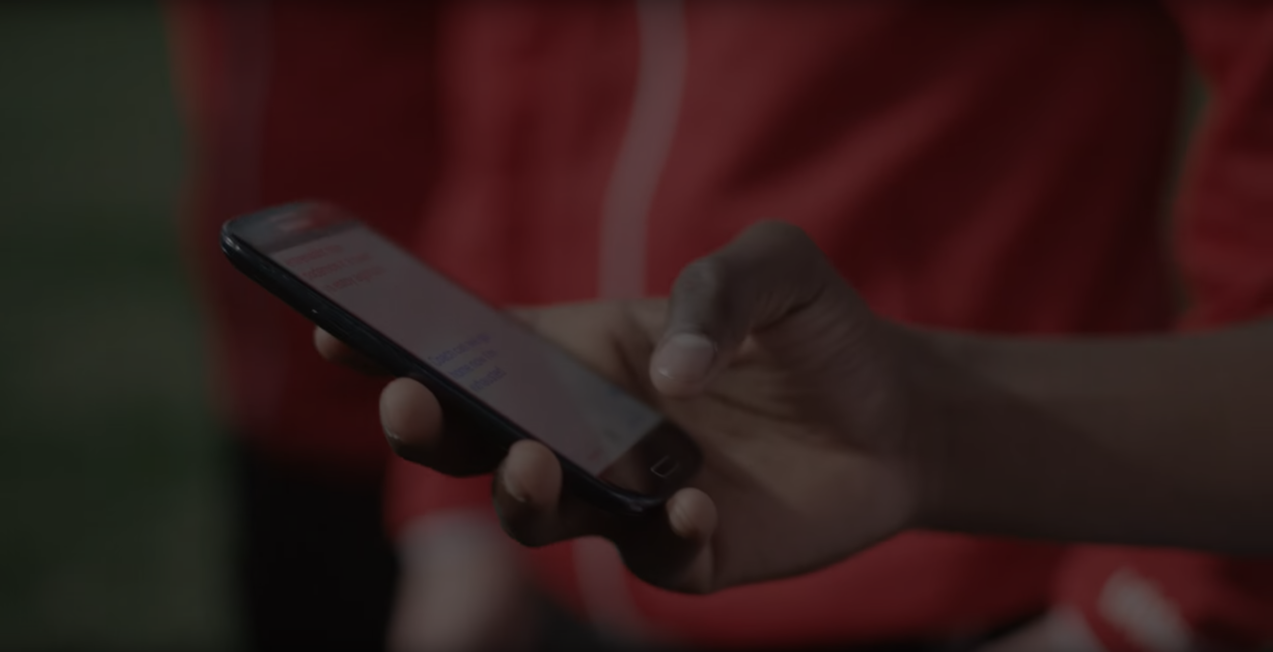
Remember, it’s not about what you know, it’s about who you know

